Slide 1
Visualization Using Nvd3 Charts

Slide 2
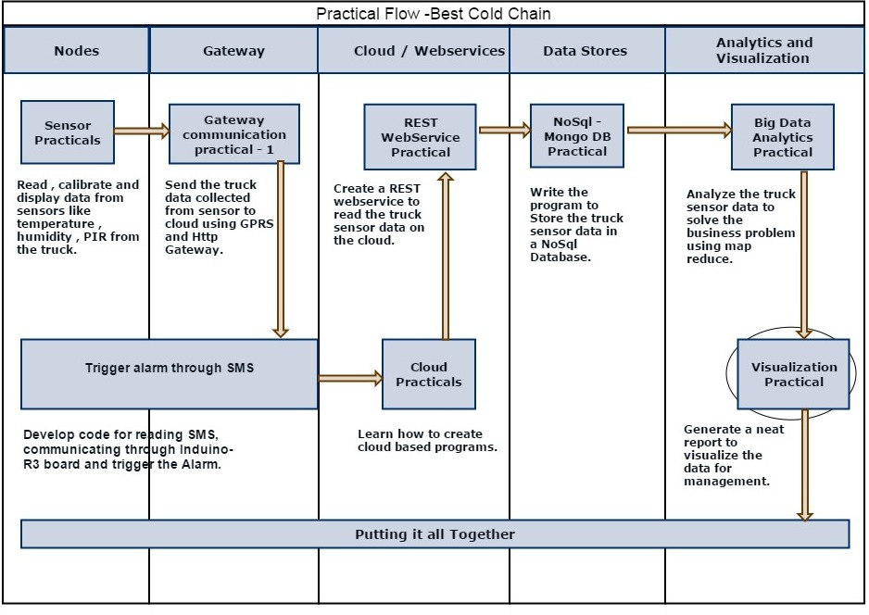
End to End Flow Diagram

Slide 3
NVD3
NVD3 is a javascript visualization library.
Internally it uses d3.js which is the one of best customizable visualization library.
This is a very young collection of components, with the goal of keeping these components very customizable.

Slide 4


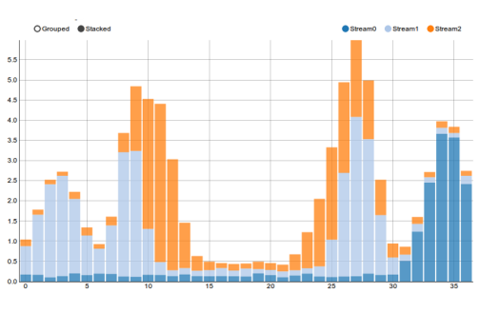
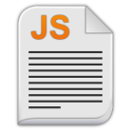


Flow Diagram
Preview on Browser
servlet
D3.js
MongoDB
Database
nvd3.js
nvd3.css
Html file

Slide 5
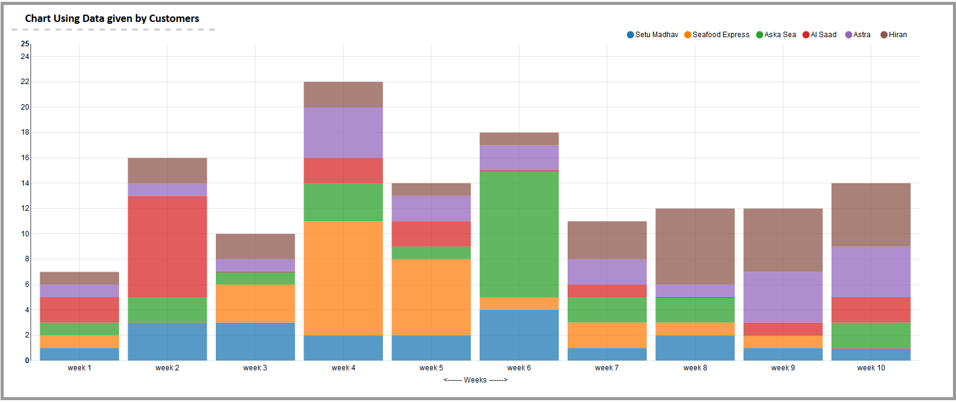
Business Scenario
Best cold chain company is facing huge claims for delivery of spoilt Fish. Below Chart describes the number of claims received in last 10 weeks.
Axelta has installed devices on vehicles, these devices sends the data to the Axleta Platform. Write map-reduce to analyze fault claims and display in chart.

Slide 6
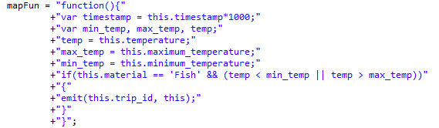
Map function

Slide 7
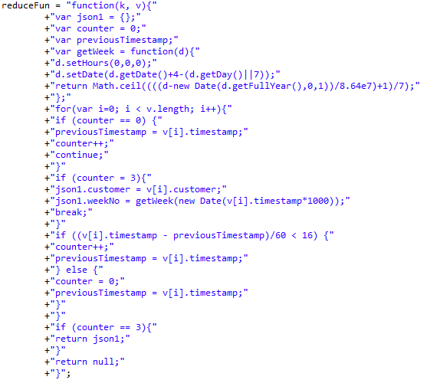
Reduce function

Slide 8
Executing Map-Reduce
MapReduceOutput mapReduceOutput = collection.mapReduce(mapFun, reduceFun, null, OutputType.INLINE, null);

Slide 9
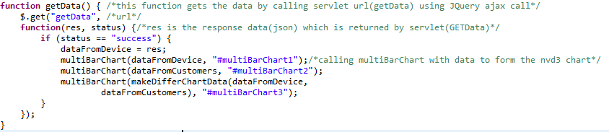
Ajax call

Slide 10
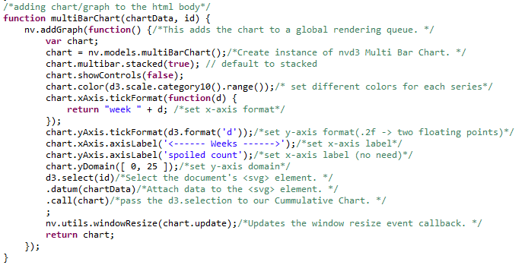
Nvd3 code

Slide 11
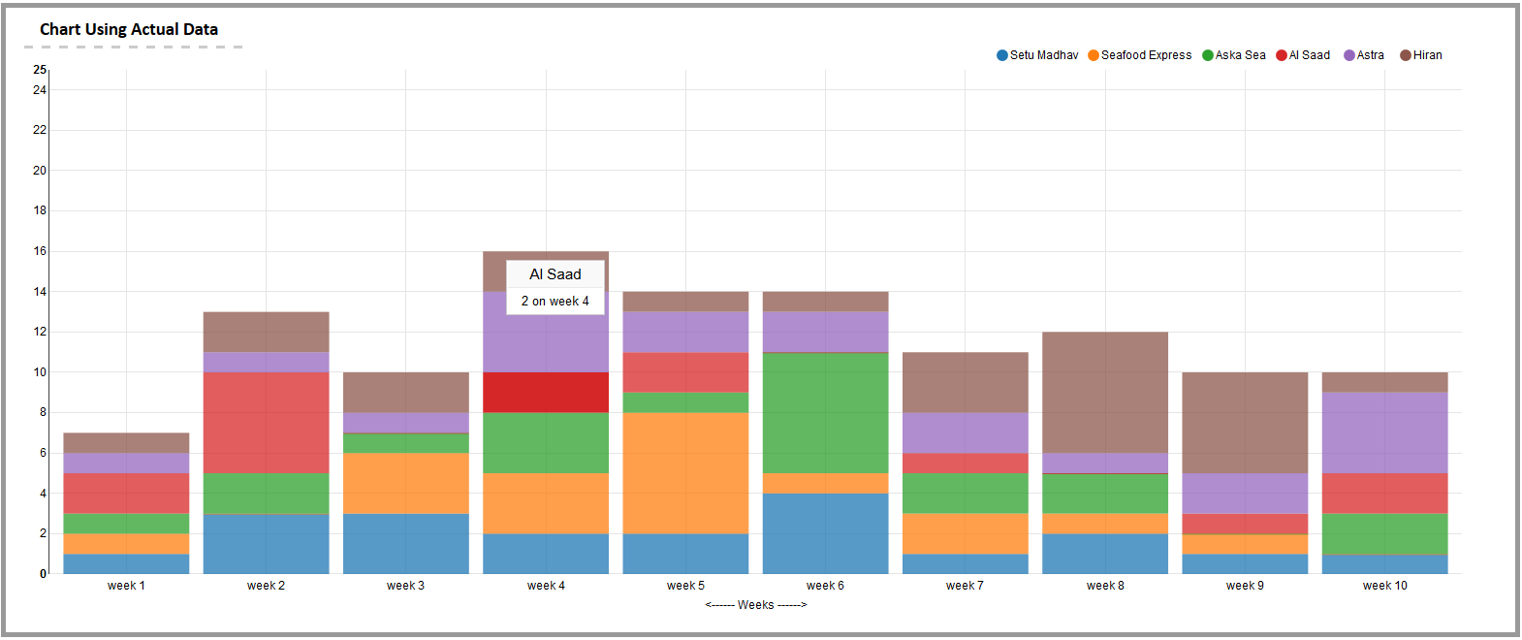
Below chart describes the genuine claims which we got from the axelta platform.

Slide 12
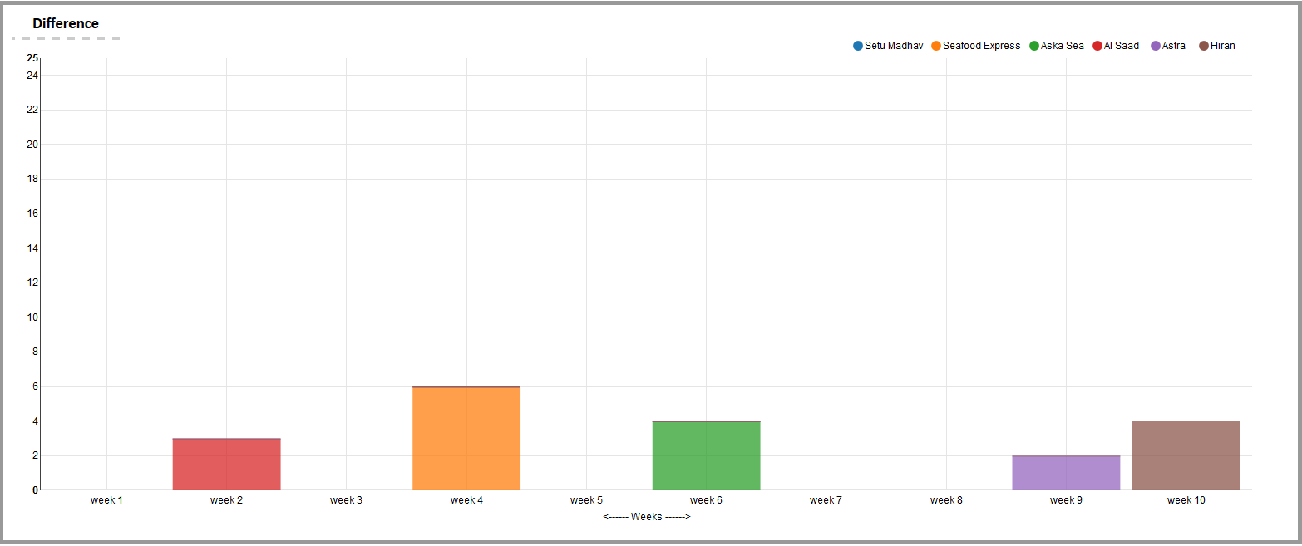
Below chart describes the fault claims

Slide 13
Thank You

